Slide 1
s
e
c
o
n
d
C
O
R
N
A
N
I
T
H
I
S
8.1-15
A free CD of this message will be available following the service
It will also be available for podcast later this week at calvaryokc.com

Slide 2
1 Cor. 16:1-3 - ¹ Now concerning the collection for the saints, as I have given orders to the churches of Galatia, so you must do also: ² On the first day of the week let each one of you lay something aside, storing up as he may prosper, that there be no collections when I come.
O
A
N
S
8.1-15
I
I
s
e
c
o
n
d
C
R
N
T
H

Slide 3
1 Cor. 16:1-3 - ³ And when I come, whomever you approve by your letters I will send to bear your gift to Jerusalem.
O
A
N
S
8.1-15
I
I
s
e
c
o
n
d
C
R
N
T
H

Slide 4
O
A
N
S
8.1-15
I
I
s
e
c
o
n
d
C
R
N
T
H

Slide 5
KJV - Moreover, brethren, we do you to wit of the grace of God bestowed on the churches of Macedonia
O
A
N
S
8.1-15
I
I
s
e
c
o
n
d
C
R
N
T
H

Slide 6
O
A
N
S
8.1-15
I
I
s
e
c
o
n
d
C
R
N
T
H

Slide 7
Grace (v. 1) - charis – 10x in chapters 8-9
7x in chap. 8; 3x in chap. 9
J. Vernon McGee - “The grace of God is the passion of God to share His goodness with others.”
O
A
N
S
8.1-15
I
I
s
e
c
o
n
d
C
R
N
T
H

Slide 8
O
A
N
S
8.1-15
I
I
s
e
c
o
n
d
C
R
N
T
H

Slide 9
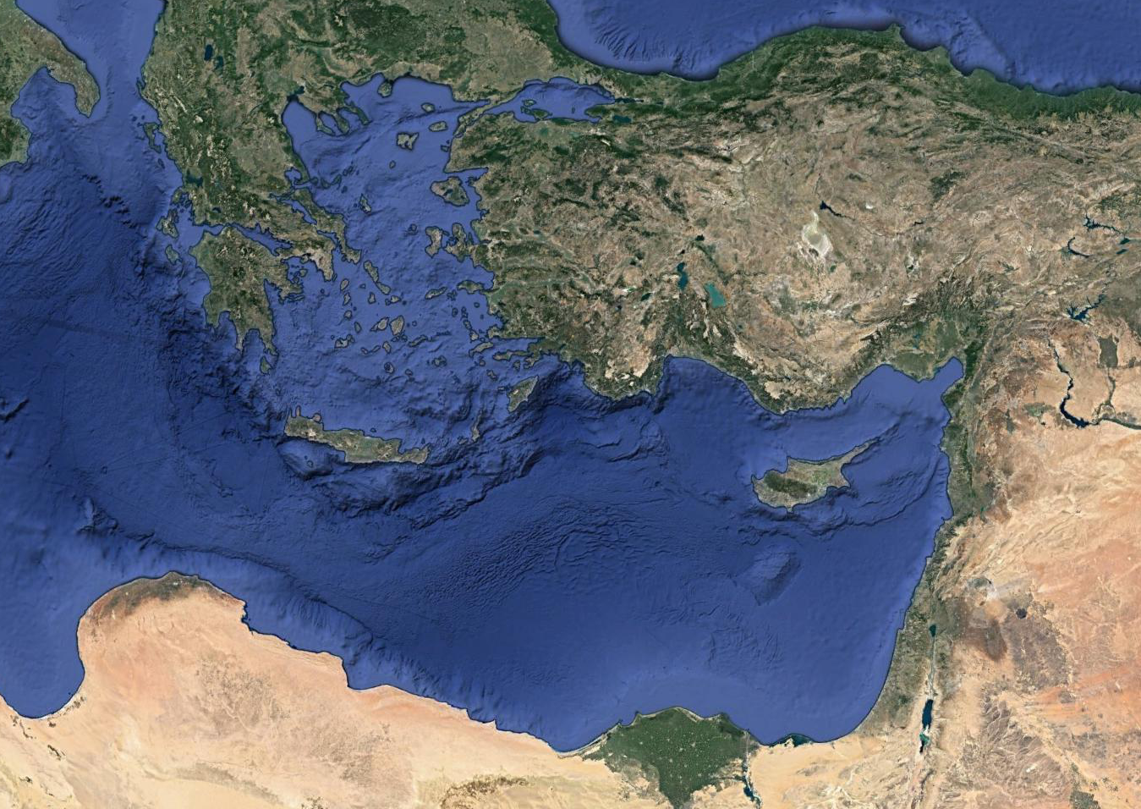
Thessalonica
Philippi
Berea
Macedonia
Corinth
Achaia
Greece
Mediterranean Sea
O
A
N
S
8.1-15
I
I
s
e
c
o
n
d
C
R
N
T
H

Slide 10
O
A
N
S
8.1-15
I
I
s
e
c
o
n
d
C
R
N
T
H

Slide 11
Testing - dokimazō – prove, approve, try, examine
O
A
N
S
8.1-15
I
I
s
e
c
o
n
d
C
R
N
T
H

Slide 12
O
A
N
S
8.1-15
I
I
s
e
c
o
n
d
C
R
N
T
H

Slide 13
Ps. 50:10-12 - ¹⁰ For every beast of the forest is Mine,
And the cattle on a thousand hills.
¹¹ I know all the birds of the mountains,
And the wild beasts of the field are Mine.
¹² If I were hungry, I would not tell you;
For the world is Mine, and all its fullness.
O
A
N
S
8.1-15
I
I
s
e
c
o
n
d
C
R
N
T
H

Slide 14
O
A
N
S
8.1-15
I
I
s
e
c
o
n
d
C
R
N
T
H

Slide 15
Winston Churchill - “We make a living by what we get; we make a life by what we give.”
O
A
N
S
8.1-15
I
I
s
e
c
o
n
d
C
R
N
T
H

Slide 16
O
A
N
S
8.1-15
I
I
s
e
c
o
n
d
C
R
N
T
H

Slide 17
William Carey - “I was once young and now I am old, but not once have I been witness to God’s failure to supply my need when first I had given for the furtherance of His work. He has never failed in His promise, so I cannot fail in my service to Him.”
O
A
N
S
8.1-15
I
I
s
e
c
o
n
d
C
R
N
T
H

Slide 18
Joe Focht - “Communism says, ‘What’s yours is mine.’
“Capitalism says, ‘What’s Mine is mine.’
“Christianity says, ‘What’s Mine is yours.’
O
A
N
S
8.1-15
I
I
s
e
c
o
n
d
C
R
N
T
H

Slide 19
O
A
N
S
8.1-15
I
I
s
e
c
o
n
d
C
R
N
T
H

